Slide 1



USA Car Accidents

Slide 2
Datasets
This Dashboard uses two datasets:
The main Dataset contains all the data about the accidents. It comes from Kaggle .com
The Second one contains data about the population of the USA states in the studied years. It will be used to calculate the ‘accident every 100.000 people’ ratio.

Slide 3
Population Dataset
This dataset has one column for the year and one for each US state
Each row stores the population of the specific state in that specific year
Year,Alabama,Alaska,Arizona,Arkansas,California,Colorado,Connecticut,[...] 2016,4860545,741522,6941072,2989918,39250017,5540545,3576452,
2017,4874747,739786,7044008,3001345,39536653,5607154,3573880,
[...]

Slide 4
Accident Dataset
This dataset contains data of about 7,7 million accidents between the years 2016-2023. The analysis will only be focused on the years 2019-2020-2021-2022 because the other years contained much less entries.
For time reasons a sampled subset of the dataset will be used. The sampled subset is obtained with the Sample function and then saved with the to_csv method

Slide 5
Accident Dataset: Sampling
import pandas as pd
import math
#Sampling Factor
SamplingFactor = 50
#Path to dataset to Sample
Path_To_Dataset = 'Dataset\\US_Accidents.csv'
# load dataset
df = pd.read_csv(Path_To_Dataset)
# sample the dataset
name = (Path_To_Dataset.split('.'))[0]
name = str(name + '_Sampled.csv')
number_of_samples = max(math.floor(((df.shape)[0])/SamplingFactor), 1)
df = df.sample(n = number_of_samples, random_state = 351)
# save sampled dataset
df.to_csv(name)

Slide 6
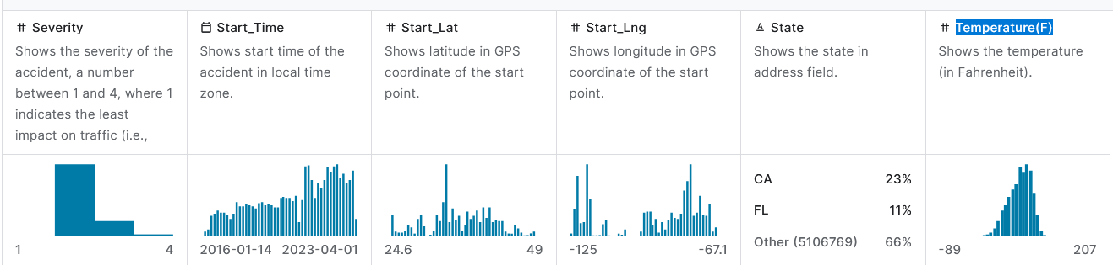
Accident Dataset
The main columns that will be used are: Severity, Start_Time, Start_Lat, Start_Lng, State, Temperature(F)

Slide 7
Accident Dataset: changes made
A few changes where necessary in order to use the dataset later:
Severity is converted to string so that plotly considers it a categorial data
Start_Time is converted into datetime format. From it are derived a few other columns (Year, Month, Day, Hour).
State is converted from the code format to the full name (CA -> California, LA-> Los Angeles...)
Temperature(F) is converted from Fahrenheit to Celsius and renamed to Temperature(C)

Slide 8
Accident Dataset: changes made
import pandas as pd
# import datset
df_acc = pd.read_csv(Path_to_accident_dataset)
# remove unecessary columns
df_acc.drop(['Source', 'End_Lat', 'End_Lng', 'Description', 'Airport_Code'], axis=1, inplace=True)
# remove null values
df_acc.dropna(inplace=True)
# Convert 'Start_Time' and 'End_Time to datetime
df_acc['Start_Time'] = pd.to_datetime(df_acc['Start_Time'],format='ISO8601')
df_acc['End_Time'] = pd.to_datetime(df_acc['End_Time'],format='ISO8601')
# add year column
df_acc['Year'] = df_acc['Start_Time'].dt.year

Slide 9
Accident Dataset: changes made
# add month column
df_acc['Month'] = df_acc['Start_Time'].dt.month
df_acc['Month'] = df_acc['Month'].replace(MONTH_MAP)
# add day column
df_acc['Day'] = df_acc['Start_Time'].dt.day_of_week
df_acc['Day'] = df_acc['Day'].replace(DAY_MAP)
# add hour column
df_acc['Hour'] = df_acc['Start_Time'].dt.hour
df_acc['Hour'] = df_acc['Hour'].replace(HOUR_MAP)
# Map the full state names to the DataFrame
df_acc['State'] = df_acc['State'].map(STATE_MAP)

Slide 10
Accident Dataset: changes made
# Convert the 'Severity' column to a string type
df_acc['Severity'] = df_acc['Severity'].astype(str)
# convert temperature from fareneight to celsius
df_acc['Temperature(F)'] = (df_acc['Temperature(F)'] - 32) * 5.0/9.0
df_acc.rename(columns={'Temperature(F)': 'Temperature(C)'}, inplace=True)
# remove year 2016, 2017, 2018, 2023 because they are incomplete
df_acc = df_acc[(df_acc['Start_Time'].dt.year != 2016)]
df_acc = df_acc[(df_acc['Start_Time'].dt.year != 2017)]
df_acc = df_acc[(df_acc['Start_Time'].dt.year != 2018)]
df_acc = df_acc[(df_acc['Start_Time'].dt.year != 2023)]

Slide 11
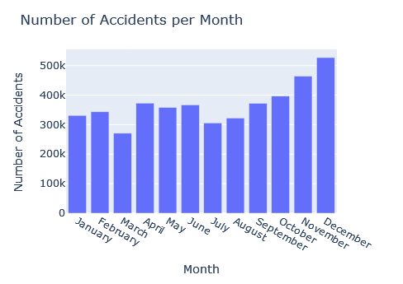
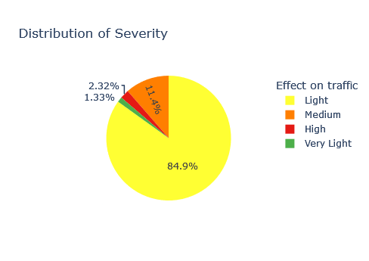
Accident Dataset: Graphs

Slide 12
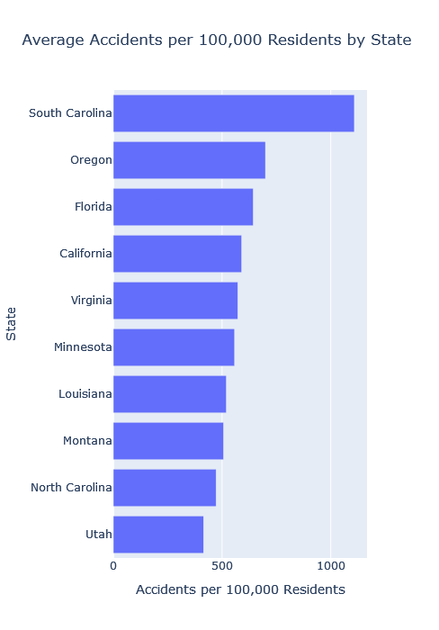
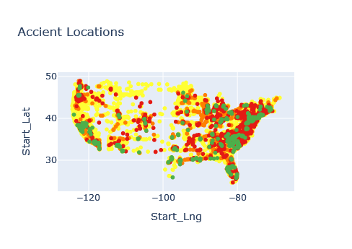
Accident Dataset: Graphs

